Slide 1
Iso-Kinetic Sampling Training Course
Dr Roger S Brown
Oakwood Environmental Services
Tel: 020 8844 0914
Fax: 020 8384 0767
Mob: 077 99 62 3891
Email: r s.brown@oakwood-environmental.co.uk
Web: www.oakwood-environmental.co.uk

Slide 2
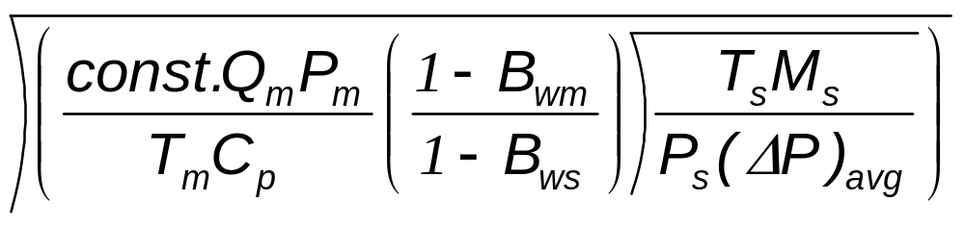
Nozzle Calculations
D_{n} =
Constant = 0.6071
Qm: ideal meter flow rate for system
Cp: Pitot Tube Coefficient
Temperature of Meter
Bws: Moisture Content of stack as a fraction i.e 6% is 0.06
Bwm :Moisture Content of Meter (usually zero)
Ms: Molecular Weight of the Stack Gases including moisture
Ps & Pm: Pressure in the Stack and Meter respectively
ΔP The differential pressures arising from the velocity of gases
Ts & Tm: Temperature of the stack and meter respectively

Slide 3
Molecular Weight Determination
Using what ever means to determine major constituents of flue gas CO₂, O₂, CO by difference calculate N₂
N₂= 100-(%O₂+%CO₂+%CO)
Calculate dry molecular weight of gases
M_{d}=0.44(%CO₂)+0.32(%O₂)+0.28(%N₂+%CO)
Now Calculate Stack gas (wet) molecular wt
Ms=0.18(%H₂O)+M_{d}(100-%H₂O)/100

Slide 4
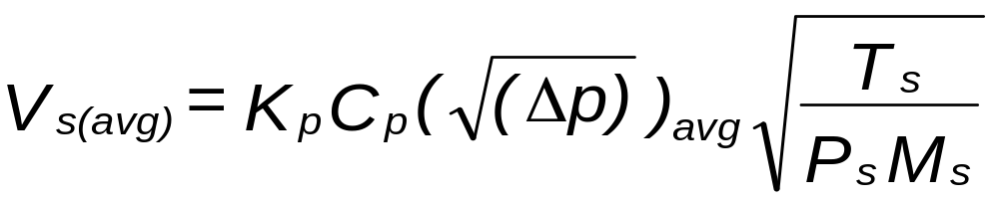
Velocity in the Stack
AVERAGE STACK GAS VELOCITY
Kp= 34.97
Cp=0.84 for s-type pitot
Cp= 1.0 for L-type pitot

Slide 5
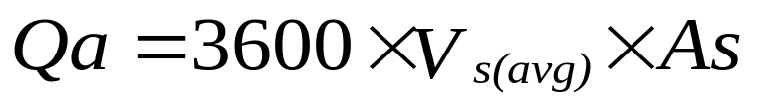
Flow in the Stack
Vs(avg)= Velocity m/s
As=Area of stack
Qa= Flow in stack at stack conditions in m3/hr

Slide 6
Calculations Used in Reporting Data
Velocity Calculations give data at flue gas conditions
To calculate Flow at other Conditions use the Ideal Gas equation to correct volumetric flow rates
Correct using PV= nRT

Slide 7
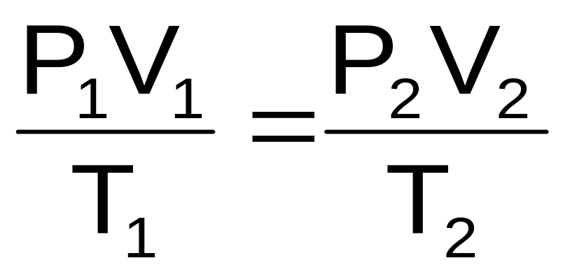


Ideal Gas Equation in Practice
V₂<V₁
P₁, T_{1,} V₁
P₂, T_{2,}
V₂
T₂<T₁ or P₂>P₁

Slide 8
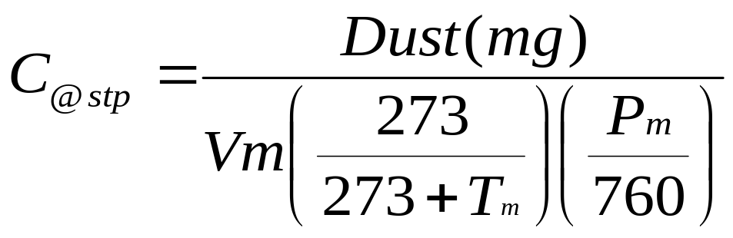
Mass Concentration
Vm=Volume Passed by Gas Meter m³
Pm= Meter Pressure mmHg
Tm= Meter Temp (ºC)
C= Particulate Concentration mg/Nm³

Slide 9
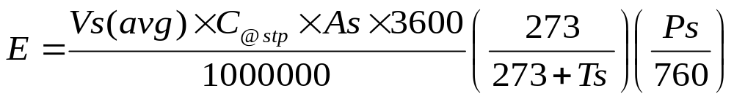
Mass Emission
Vs=velocity in stack m/s
Ps=Stack Pressure mmHg
Ts=Stack Temp (ºC)
C= Particulate Concentration mg/Nm³
As=Area of Stack m²
E=Mass Emission kg/hr

Slide 10
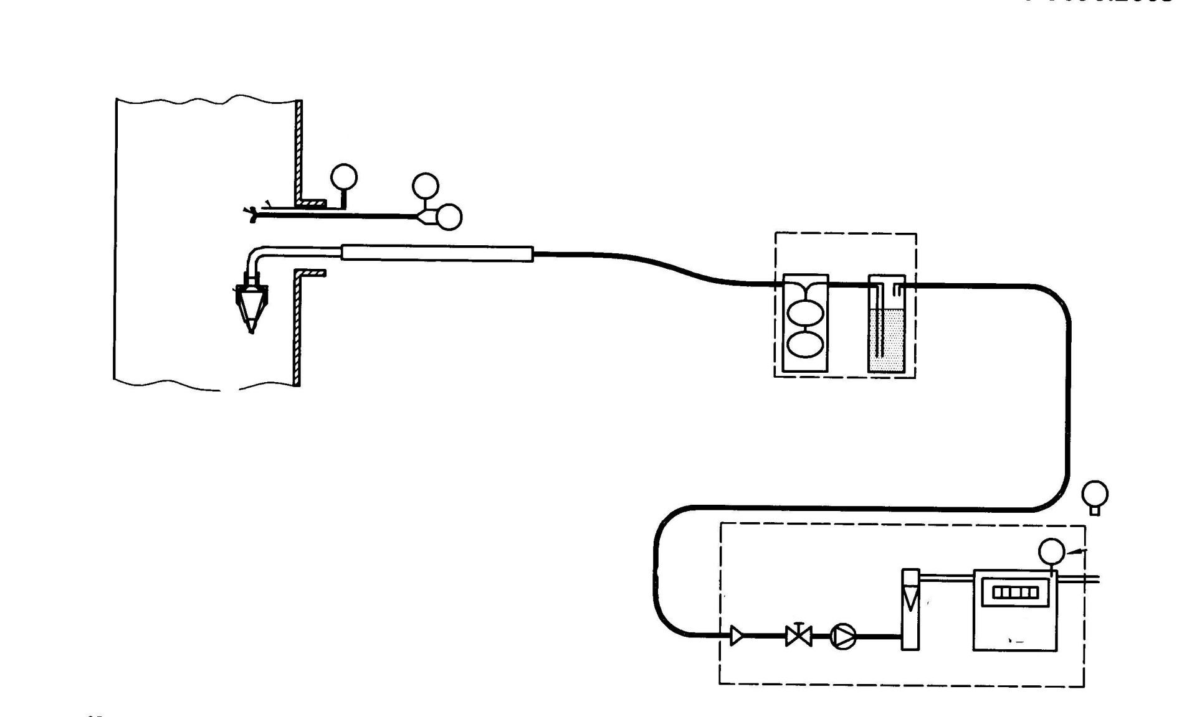
Relationship of flow at Gas Meter and Stack Velocity
Wet Gas
Ps
Ts
Δp
Vn
Vs
Tm
Vm
Dry Gas
Pm

Slide 11
Two Different Conditions
Important
The velocity measurements are corrected from stack gas temperature and Pressure Ts & Ps and Wet Gas
Whilst
The Gas Volume Measurements are corrected from the temperature and pressure of the meter and atmospheric pressure Tm & Pm (Pbar+ΔΗ) and Dry Gas Basis

Slide 12
How is Sampling Rate Set
Select a Nozzle which is within the flow rate achievble by the Pump
Calculate the flow rate required through the size of nozzle selected such that Vn = VS taking into account the temperature of the gas meter and flow meter and the temperature of the stack.
    Use a Spread Sheet on a computer
    Use a nomograph Slide Rule
    Use a programmed Calculator

Slide 13
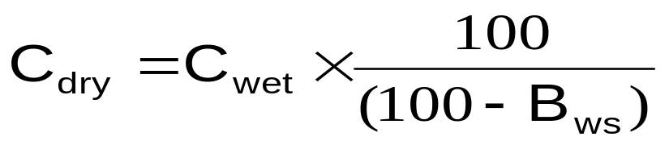
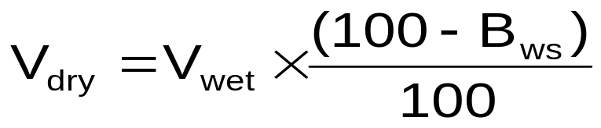
Moisture Calculations
Moisture
Wet Gas Conditions to Dry Gas Conditions: Bws is the moisture content as a percentage
Concentrations mg/Nm³
Volume or Flow

Slide 14
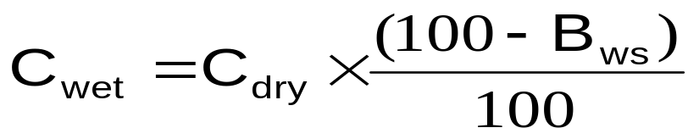
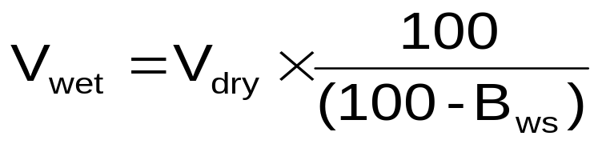
Moisture Calculations
Moisture
Dry Gas Conditions to Wet Gas Conditions: Bws is the moisture content as a percentage
Concentrations mg/Nm³
Volume or Flow

Slide 15
Reference Conditions
In the EU and UK data can be expressed in several standard ways
  At 273K (0ºC), 101.325kPa (1atm), and on a wet gas basis
  At 273K (0ºC), 101.325kPa (1atm), and on a dry gas basis
  At 273K (0ºC), 101.325kPa (1atm), and on a Dry gas basis and at reference Oxygen conditions
  Incinerators use 11% O₂; Gas Turbines 15% O₂; Oil & Gas 3% O₂ and Coal and Solid Fuels 6% O₂

Slide 16
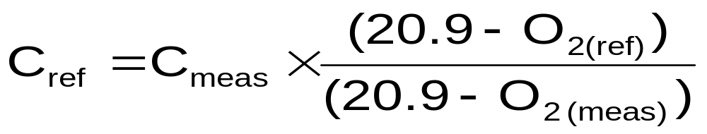
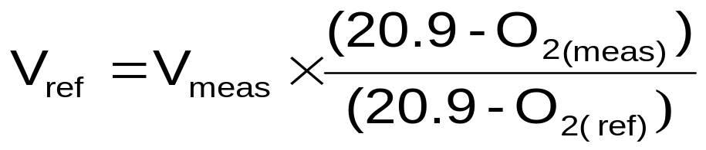
Oxygen Calculations
Oxygen
Concentration of Species Cref at Reference Oxygen Conditions
Concentrations mg/Nm³
Volume or Flow

Slide 17
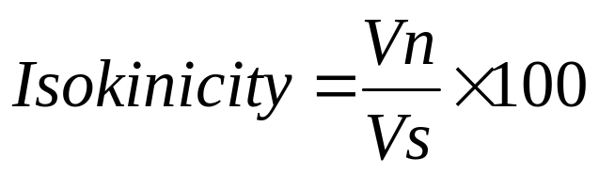
Isokinicity
Isokinicity must be in Range of 95 to 115%

Slide 18
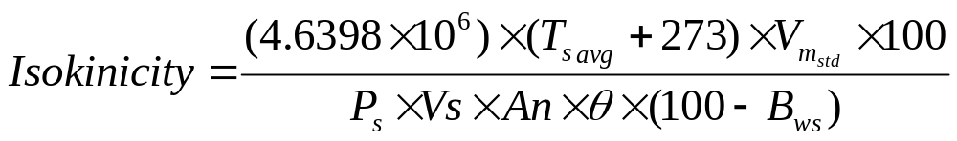
Isokinicity
An= Area of Nozzle mm²
Bws=%Moisture in stack
Ps =Pressure in stack (absolute) mmHg
Vs=Stack gas velocity m/s
Vm_{std=}Volume of gas passed through gas meter at stp (m³)
Ts_{avg=} Average Temperature of stack (K)
θ= total sampling time (min)

